Slide 1
Classical Floorplanning Harmful?
Andrew B. Kahng
UCLA Computer Science Department
ISPD-2000
http://vlsicad.cs.ucla.edu

Slide 2
Outline
Context
Observations
Complaints
Needs
End

Slide 3
Context

Slide 4
Convergent Chip Implementation
Complexities: design, silicon, constraints
Must converge: logic, timing, spatial embedding
Technique 1: Successive approximation
  mostly-forward (correct-by-construction) (== stepwise refinement)
    intentions, assumptions passed downstream
    tool predictors, approximate analyses passed upstream
  somewhat-iterative (construct-by-correction)
Technique 2: Separation of concerns
  e.g., front end (“logic/timing”) vs. back end (“spatial embedding”)
Technique 3: Elimination of concerns
  reduced degrees of freedom, pre-emptive design techniques
  e.g., power distribution, repeater rules for signal integrity
Design Planning = Apply Techniques with Minimum Loss

Slide 5
Planning in Chip Implementation
Input: RT-level HDL + technology + constraints
Output: recipe for invocation and composition of “commodity” SP&R or list of RTL code problems
Successive approximation of spatial embedding
    end up with a (top-down) coarse placement
    can induce a final physical hierarchy
Successive approximation of logic, timing
    end up with an implementable-to-spec RTL design
    induces a near-final logical hierarchy
    human fanout limitations: natural sequence of no-FP, phys-FP, RTL-FP...
“Logical and physical hierarchies co-evolve”
Details:
    pin optimizations, interconnect planning, hierarchy reconciliations, budgeting mechanisms, compatibility with downstream SP&R tools, ...

Slide 6
Observations

Slide 7
Observation 1
“Classical floorplanning” ≈ top-down coarse placement
10 years ago, this was a perfect fit...
  silicon:
    gate-dominated path delays → block packing with simple objective
    2-LM → variable-die regime, channel routing, slicing trees, ...
  design:
    gate-level → no uncertainty in the placement instance
    low gate count → only structured-custom teams did “top-down planning”
    small block complexity (+ simple objective) → anneal a representation
...but the problem has changed
  silicon:
    interconnect influence on timing → need to plan it
    N-LM → fixed-die regime
  design:
    RT-level planning → uncertain block area and timing; IP reuse ...
    “merged ASIC, structured-custom methodology” → not flat any more

Slide 8
Observation 2
Academia has forgotten the equation: “classical floorplanning ≈ top-down coarse placement”
Sequence pairs, bounded-slicing grids, ... == preoccupation with flat coarse placement
But, goal is early feedback in top-down design process
Observation 3
Academia has not adapted floorplanning formulations to new silicon and design requirements
Key examples: fixed-die context, increased importance of connectivity, RT-level uncertainties, front-end signoff, ...

Slide 9
Complaints

Slide 10
Complaint 1: The Packing Obsession
“Complete” representations are awkward
  heavy coercion for fixed, semi-soft, aligned, pitch-matched, ...
  poor scalability, unclear quality of results
  Reward Offered: 1 professor’s car for optimal solver of small instances within 60 CPU seconds (single Intel/Sun processor)
    10 blocks, 10 rectangular shapes per block, 16 external terminal locations, 1000 integer-weighted nets in netlist, fixed containing region with 10% whitespace, minimum total weighted HPWL objective with block-center pin locations
    (car = 1988 Honda Accord LX, auto, 152K miles, ... or BlueBook equiv)
Representations much less convenient than realizations
  search over representations difficult with complex objectives
Wirelength, path timing → must be connectivity-centric
  Life is short. Packing is hard. (Just avoid it.)

Slide 11
Complaint 2: Methodology Irrelevance
Recall: goal is to feed instance(s) to commodity SP&R
Pre-synthesis planning has inherent large uncertainties
    (Sarrafzadeh: floorplanning w/uncertainty, partial information, ...)
Impedance mismatch :
  +/- 15% pre-synthesis area, timing estimates
  great effort spent packing blocks that will change
Need relative coarse timing-driven placement that is adaptable to ECOs
  also need power, clock, global signal planning (includes pin optimization, interconnect optimization)
  THIS IS A PLACEMENT PROBLEM !!!
Other issues are in controllability of SP&R back end
  e.g., “symbolic-hard” pre-routes, context-insensitive design

Slide 12
Complaint 3: Overconstrained Shaping
Why rectangles, L’s, T’s ?
  available granularity is by site spacing, row height
  placers can handle arbitrarily complex region constraints
  hard IP reuse, generated modules benefit from shape freedom
Why non-overlapping ?
  only requirement: total assigned cell area ≤ total resource area
Roundness and shape simplicity are mythical needs
  constructive pin assignment → don’t need roundness
  path timing optimization → may even want disconnected shapes

Slide 13
This is Okay, Really... (Trust Me)
1.0
0.5,0.5
1.0
Blk A
Blk B

Slide 14
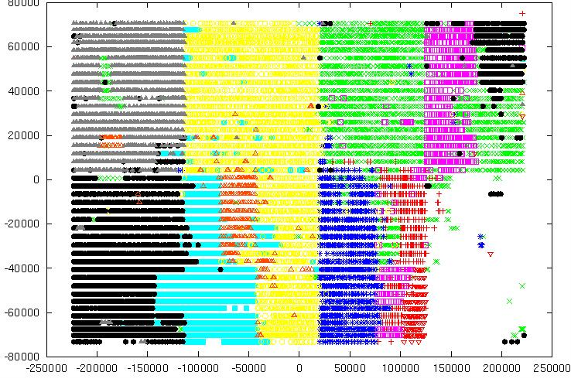
...The Cells Won’t Mind

Slide 15
Complaint 4: Underconstrained
Layout Region
Much of the literature: Constrain aspect ratio of layout region bounding box, minimize whitespace
Fixed-die reality: Layout region is fixed, deal with it
Real goal: Achieve zero-whitespace, zero-overlap

Slide 16
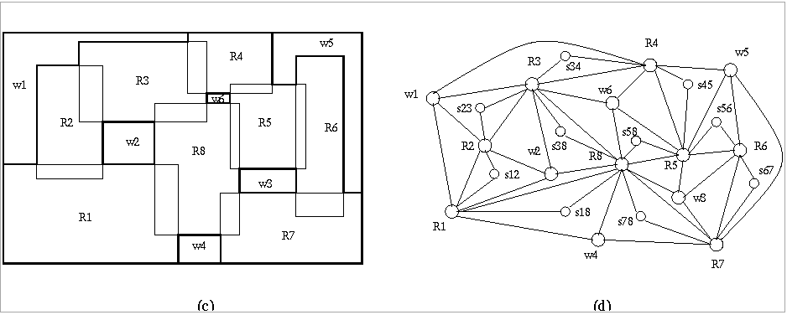
Perfect Rectilinear Floorplanning
Fixed-die planning: start with coarse global floorplan, migrate whitespace ↔ overlap such that both disappear

Slide 17
Needs

Slide 18
Need 1: Metrics
Packing-connectivity tension: flexibility metrics
  high flexibility: min whitespace consistent w/min wirelength
  low flexibility: min whitespace inconsistent w/min wirelength
  formal definition ???
For Perfect Rectilinear Floorplanning: shape metrics
  given two dissections of the layout region, what is the distance between them ?
Creation of coarse placement instance: partitioning metrics
  goal: understand interaction between block definition (i.e., RTL partitioning) and achievable coarse placement quality
  goal: recognize and cure a physically challenged logic hierarchy

Slide 19
Need 2: Clearer Context, Concepts
Is floorplanning simply coarse placement ?
  if so, engines should be placer-based, not packer-based
  new heuristics are needed for the PRFP formulation
Is logic hierarchy an essential element of the physical floorplanning problem ?
  e.g., for cross-probing, HDL diagnosis, ...
  under what circumstances is HDL structure helpful ? harmful ? irrelevant ?
Is there truly such a thing as “flat physical design” ?
  even within blocks, layer assignment and repeater solutions must be made up front
  is flat vs. block-based a “distinction without a difference” (Kurt Keutzer’s question) ? i.e., manual vs. semi-automated hierarchy management

Slide 20
Need 3: Better Wireload Models (!)
Fact: At some level, prediction ≠ construction
Can better estimate:
  to account for resource, topological heterogeneity
  to account for optimizations (placement, ripup/reroute, timing)
  ... much progress possible (see, e.g., ACM SLIP Workshop)
M_{n}
K_{n}

Slide 21
End

Slide 22
Conclusions
Classical floorplanning is not harmful
  we are returning to planning = top-down placement
  we are returning to “pin assignment and global routing” !
  ignoring consequences of silicon, design evolution is harmful
Must acknowledge complaints
  less focus on packing, more focus on connectivity !
  coarse placement → use a placer !
  methodology requirements
    uncertainty, incrementality, RT-level, timing, ...
Must acknowledge needs
  metrics
  clear purpose and context (not previous papers) driving research
  better wireload models ☺

Slide 23
Acknowledgments
Current research on PFRP, flexibility, hierarchy-aware placement: Andy Caldwell, Doug Carroll, Feodor Dragan
Years of discussions: George Janac, Ravi Varadarajan
ISPD-2000 committee and Patrick Groeneveld

